Slide 1

Twitter Positivity/Negativity Project
MICHAEL STANCO • ROMELL PINEDA • RONALD HERNANDEZ

Slide 2


Analytic Expedition
We wanted to generate analysis that provided insight on the positivity & negativity on Twitter as a whole. We were able to do this by considering the following “big-picture” questions:
WHAT MAKES A TWEET POSITIVE OR NEGATIVE IN NATURE?
IN GENERAL, ARE TWEETS MORE POSITIVE OR MORE NEGATIVE?

Slide 3

Narrowed Focus
We specifically sought to answer the following questions:
Within our criteria, are we able to accurately quantify a positive or negative tweet?
Does time of day play a role in tweet positivity/negativity?
Are active users more positive/negative?
Does age of a user account play a role in tweet positivity/negativity?
Are tweets from celebrities generally more negative than positive?
Can an observation be made about frequency of positive/negative tweets as a user’s number of followers increases?

Slide 4






Project Technologies

Slide 5
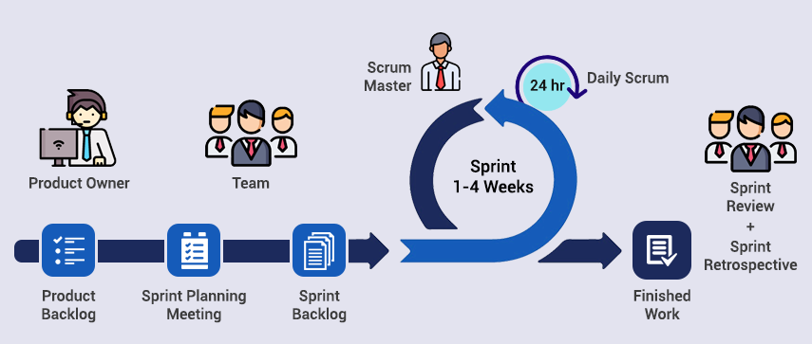
Project Framework

Slide 6

Procedure
Understand twitter v2 API data
Locate twitter data repository
Read in and process data from online twitter API
Establish criteria for positive/negative tweets
Set-up code/queries to perform analysis
Tweak criteria for positive/negative tweets, if needed
Extract analysis/findings
Compile all findings and conclusions

Slide 7
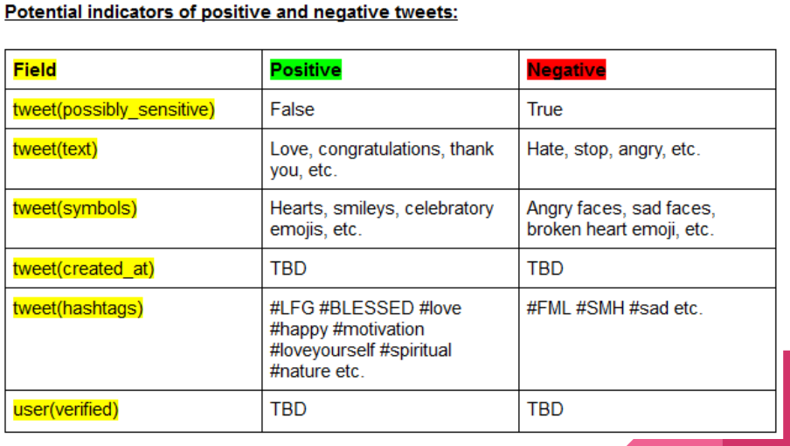
Initial Criteria for Positive & Negative Tweets

Slide 8
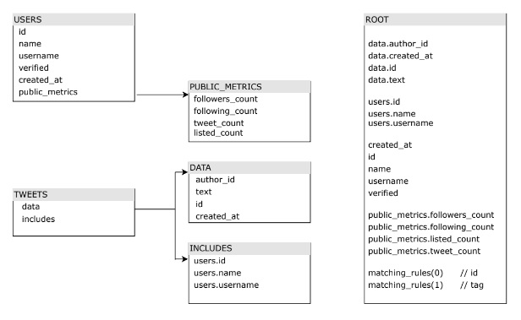
Derived Schema
The diagram on the left outlines the data that our project group pulled from the Twitter V2 API.
We obtained tweet data through filtered streaming, and then used the author IDs in the tweet data to obtain historical user data.

Slide 9
Revised Criteria for Positive & Negative Tweets Based off Derived Schema
Removed fields that were not contained within Filtered Twitter Stream V2 API
Removed hashtags because we felt the text and emojis contained within a tweet were sufficient
Added tweet count and verified status, which we ended up observing in our analysis
Field | Positive | Negative
tweet(text) | Love, congratulations, thank you, exciting, excited, favorite, fav, amazing, lovely, incredible, elated | Hate, stop, angry, stupid, horrible, worst, sucks, bad, disappointing, terrible, *cuss words*
tweet(symbols) | 😀😃😄😁😆😚😘🥰😍🤩🥳🙂☺️😊😏😋😎❤️♥️👍🙌 | 😐😰😰😔☹️🙁😕😟🥺😢😥😓😞😖😣😩😫🤢🤮💔🖕🏼
tweet(tweet_count) | Observed in analysis | Observed in analysis
tweet(created_at) | Observed in analysis | Observed in analysis
user(verified) | Observed in analysis | Observed in analysis

Slide 10
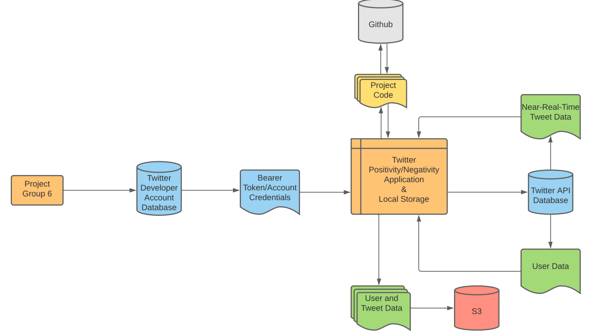
Data Flow Diagram

Slide 11
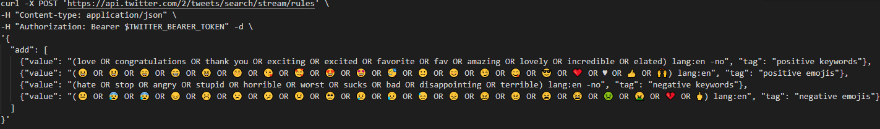
Rules for Obtaining Tweets
We used the above commands to set rules for our tweet stream based off our defined criteria
These commands gave us the capability to pull tweets that fell into the above criteria in near-real-time

Slide 12
Context of Analysis
We used two methods of obtaining data to conduct our analysis:
Pull archived data from Twitter API in mass quantities and save to local storage
Used a 131,000 tweet sample to answer analysis question #2
Used a 5,000 tweet sample to answer analysis question #3
Stream Twitter data in near-real-time
Our streamed analysis covers roughly 20,000 tweets after an hour of streaming
Used to answer analysis questions #1, #4, #5, and #6
Note: Both of the above methods used our predefined tweet rules

Slide 13
Question 1
Within our criteria, are we able to accurately quantify positive or negative tweets?
Our Approach:
Use our predefined rules to observe distributions of emojis and keywords
Manually observe resulting positive and negative tweets from our criteria

Slide 14
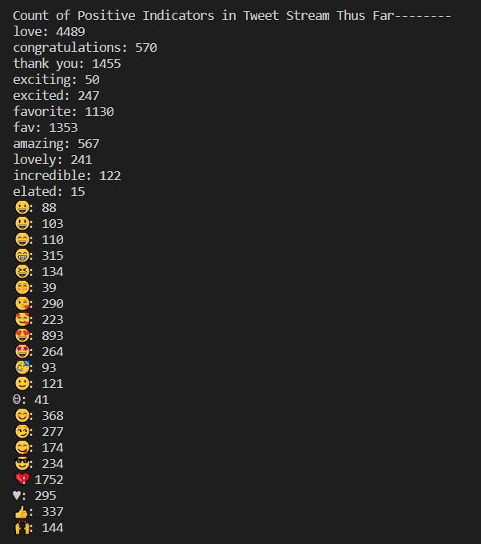
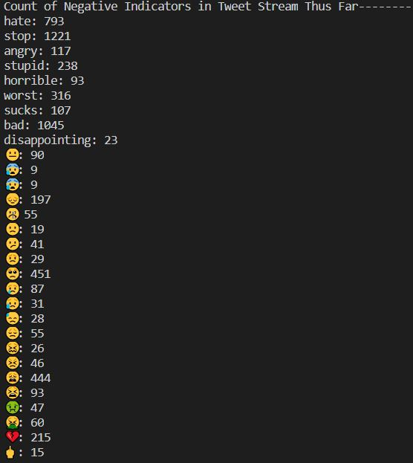
Results for Question 1 - Part 1
Outlines keyword and emoji distribution from 20,000 tweet stream
Some keywords and emojis appear more often than others
Important for our analysis

Slide 15
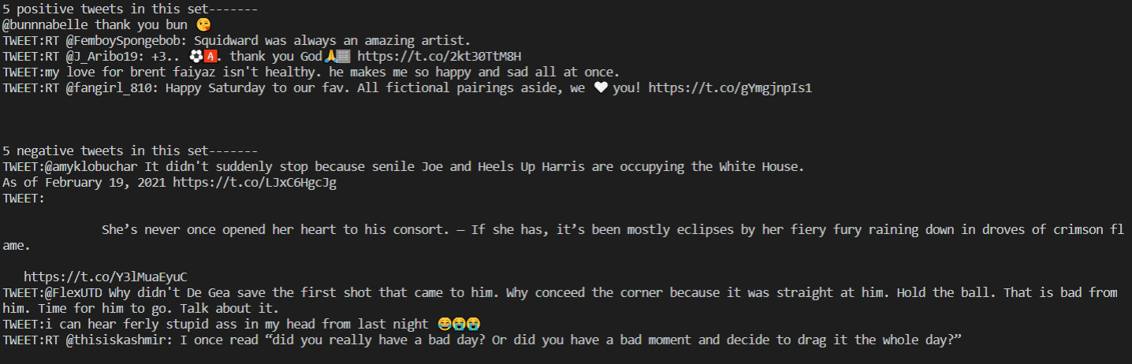
Results for Question 1 - Part 2
Five random sample positive and negative tweets are output during a stream to ensure our filter is discerning correctly between positive and negative tweets
Each tweet starts with “TWEET:”
Our model does a good job of filtering positive and negative tweets

Slide 16
Question 2
Does time of day play a role in tweet positivity or negativity?
Our Approach:
Sort positive and negative tweets from the 131,000 tweet sample in local storage
Observe total distribution of positive and negative tweets
Group by hour (UTC)
Join hourly positive and negative tweet tables

Slide 17
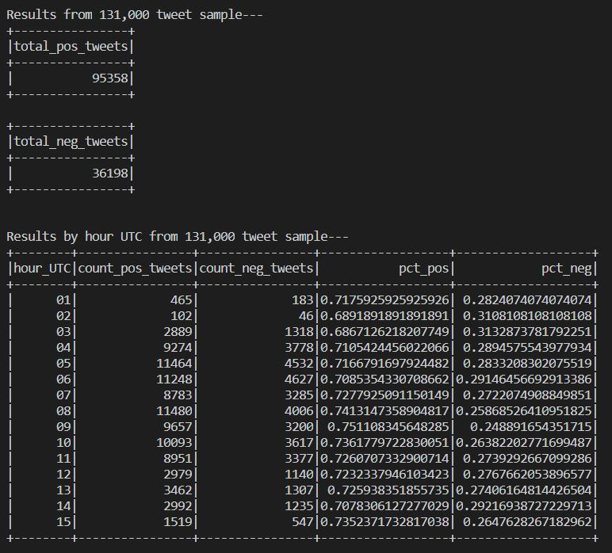
Results to Question 2
Contained in the left image:
Total number of positive tweets
Total number of negative tweets
Distribution of positive/negative tweets over a 15-hour UTC sample
Within our 15-hour sample, 72.5% of tweets were positive, while 27.5% were negative
Positive and negative tweet counts increase during prime internet hours, but no clear conclusion can be made on the distribution of tweet positivity/negativity over time

Slide 18
Question 3
Are active users more positive or negative on twitter?
Our Approach:
Separate data between positive and negative sets based on the matching tags
Obtain the average tweet per user
Separate each new set between users with above average and below average tweet count
Sum the number of positive and negative tweets per each user group
Calculate the percentages

Slide 19
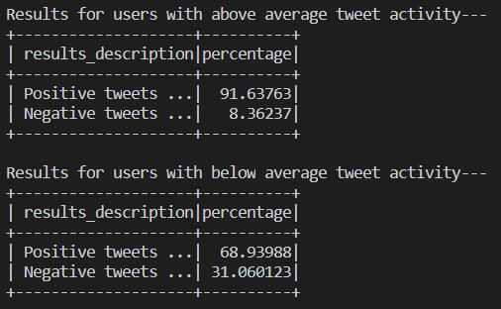
Results to Question 3
Active users are more likely to publish positive tweets (91.6%)
Users that are not active are less likely to produce positive tweets (68.9%)

Slide 20
Question 4
Does the age of a user’s tweet account play a role in tweet positivity or negativity?
Our Approach:
Separate data between positive and negative sets based on the matching tags
Determine the definition of what constitutes an older subscription between a newer one (2 years)
Separate each new set between older subscribers and newer subscribers based on account age
Sum the number of positive and negative tweets per each user group
Calculate the percentages

Slide 21
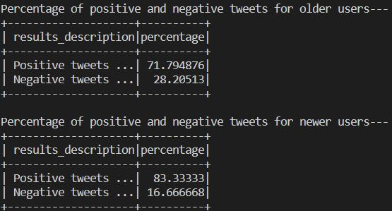
Results to Question 4
Twitter accounts created after 1/1/19 are more likely to publish positive tweets (83.3%)
Twitter accounts created before 2019 are less likely to publish positive tweets (71.8%)

Slide 22
Question 5
Are tweets from celebrities generally more negative than positive?
Our Approach:
- Select all users that posted tweets in our filtered stream
- Narrow user data to ‘verified’ = TRUE
- Compare results between positive and negative celebrity tweets
Assumption:
When a user’s twitter account is verified, it means that the account has public interest, and that it’s identity is confirmed.
Info about verified accounts:
https://help.twitter.com/en/managing-your-account/about-twitter-verified-accounts

Slide 23
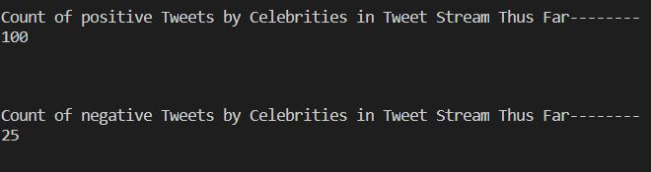
Results to Question 5
From our tweet stream, roughly four out of every five celebrity tweets were positive.

Slide 24
Question 6
Can an observation be made about frequency of positive/negative tweets as a user’s number of followers increase?
Our Approach:
- Sort out positive and negative tweets from our filtered stream
- Observe average follower counts

Slide 25
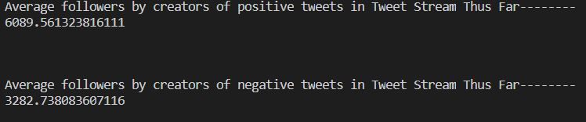
Results to Question 6
Twitter users with more followers are more likely to publish a positive tweet
This result goes hand in hand with our result from question 5 (celebrity tweets)

Slide 26
Main Takeaways from Our Analysis
Tweets published on Twitter are generally more positive than negative
Our model does a solid job of distinguishing between positive and negative tweets, but there is room for improvement
Time of day does not play a role in tweet positivity/negativity
Active users are more likely to publish positive tweets than less active users
Newer Twitter accounts are more likely to publish positive content
Tweets from celebrities and those with a larger number of followers are more likely to publish a positive tweet

Slide 27
Potential Improvements
Expand on our analysis
Larger streamed samples
Large amount of twitter positivity/negativity still unexplored (attached items, retweets, etc.)
Use machine learning to improve our model and help quantify the following:
Sarcasm
Multiple keywords and emojis (“love” vs. “I do not love this”)

Slide 28
Application Demo
Opening VSCode...

Slide 29

Questions

